Slide 1

PROGRAMMING FOR DATA ANALYTICS
BRI Audit Analytics
3 Januari 2024

Slide 2


What We Will Learn?

Slide 3
Training Objectives
1
Introduction to Dataframes
Reading data
Pandas data types
Dataframe structure
Pandas built-in statistics summary
Indexing and Subsetting
2
Slicing dataframes
Loc and iloc
Conditional subsetting
3
Referencing and Copying

Slide 4
Tools Introduction

Slide 5


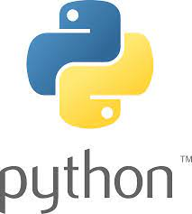
Data Analytics Tools

Slide 6

Anaconda Distribution

Slide 7
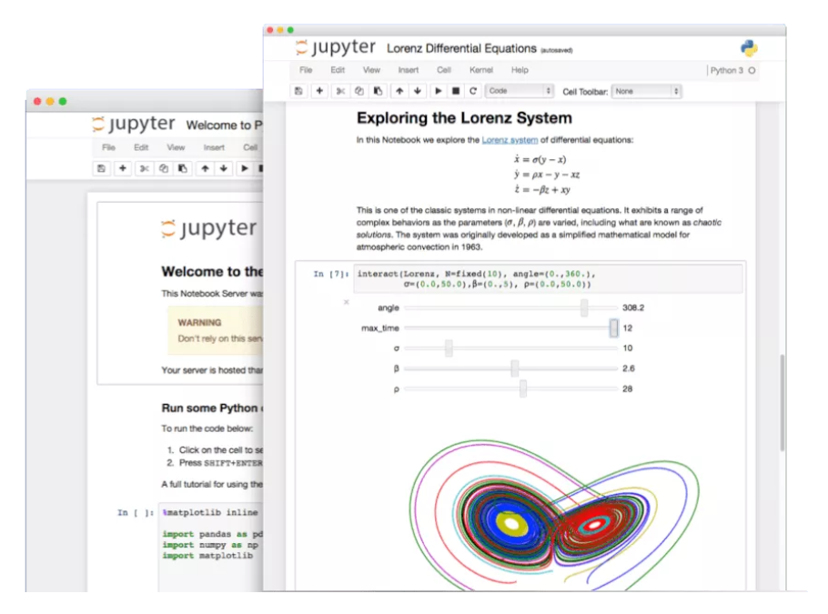
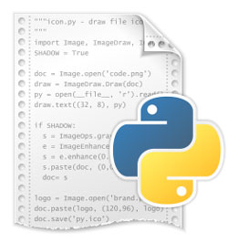

Jupyter Notebook
“Jupyter Notebook allows you to create and share documents that contain live code, equations, visualizations and narrative text” -- Oracle Blogs
In most Data Science Project, the output is either python script or a notebook
Machines runs script files
Human reads notebook files

Slide 8
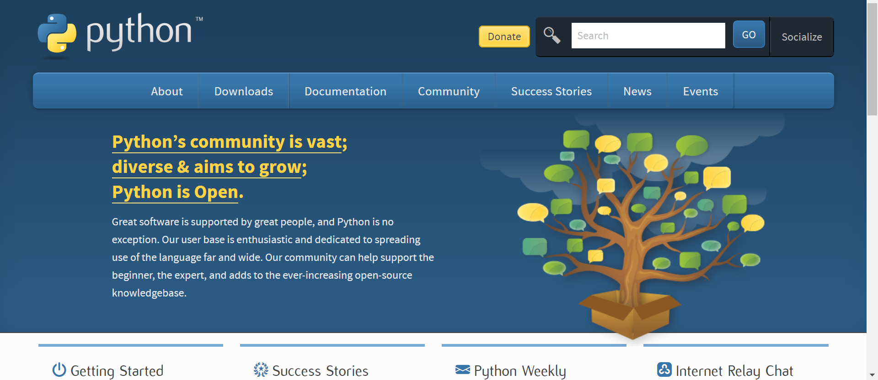
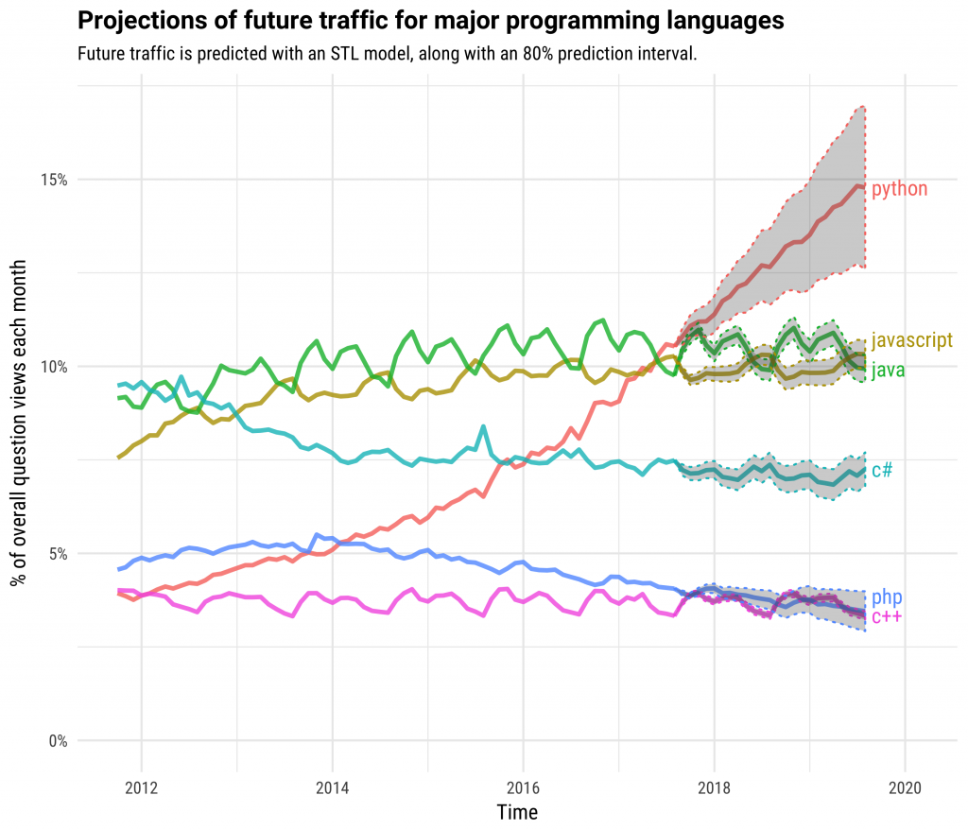
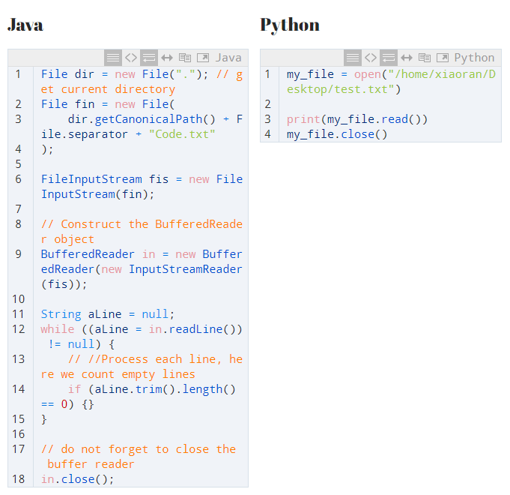
Programming Language Python
Open Source & Vibrant Community
In Demand
Code Simplicity & Readability

Slide 9





Tools Analogy
Data Analyst
Painter
Studio
Paint and Brush
Canvas

Slide 10
Material Preparation

Slide 11
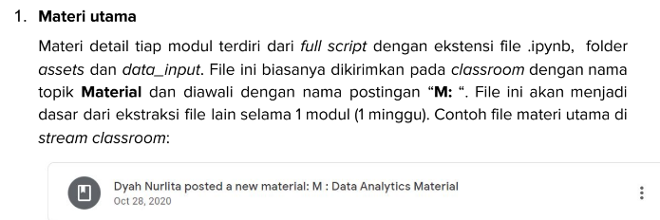
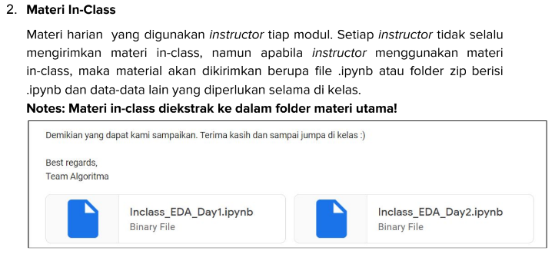
Material & In Class Preparation

Slide 12
How to Open Jupyter Notebook
Open Anaconda Prompt (anaconda3) from start/search button
Change the directory to where you placed your training folder cd C:\Users\ALGORITMA\Documents\Corporate\BRI_AUDIT (example)
> If you placed it on different drives before change the directory type this D: or F: or G: depends on your drives location
Open jupyter notebook with syntax below:
jupyter notebook

Slide 13
Additional Tools Preparation

Slide 14
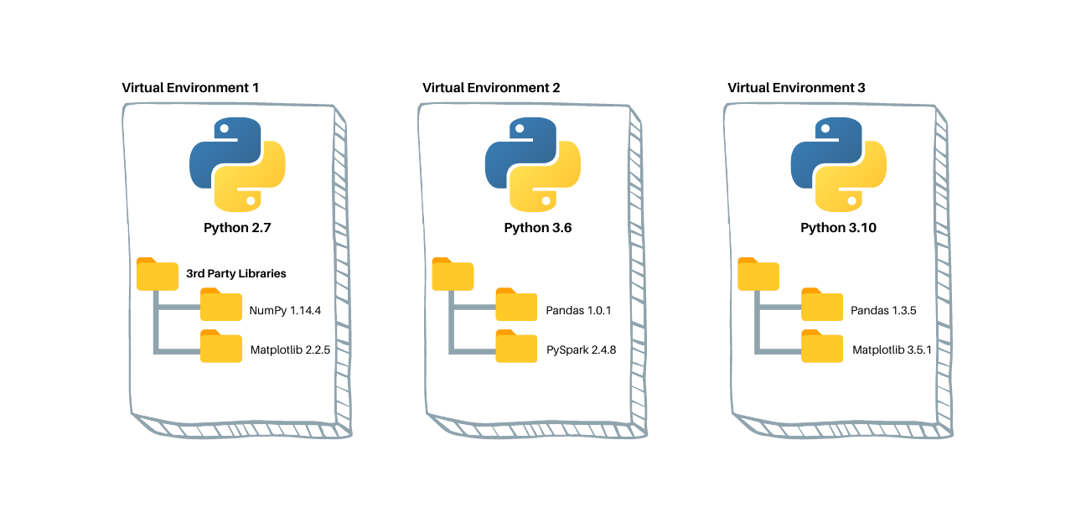
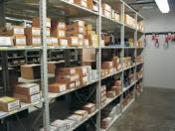
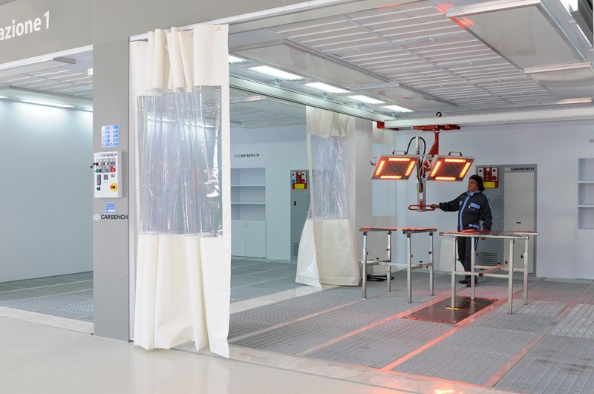
Virtual Environment
Studio
Virtual Environment 1
Inventory Room
Analysis Data
Machine Learning
Dashboarding
Virtual Environment 2
Painting Drying Room

Slide 15
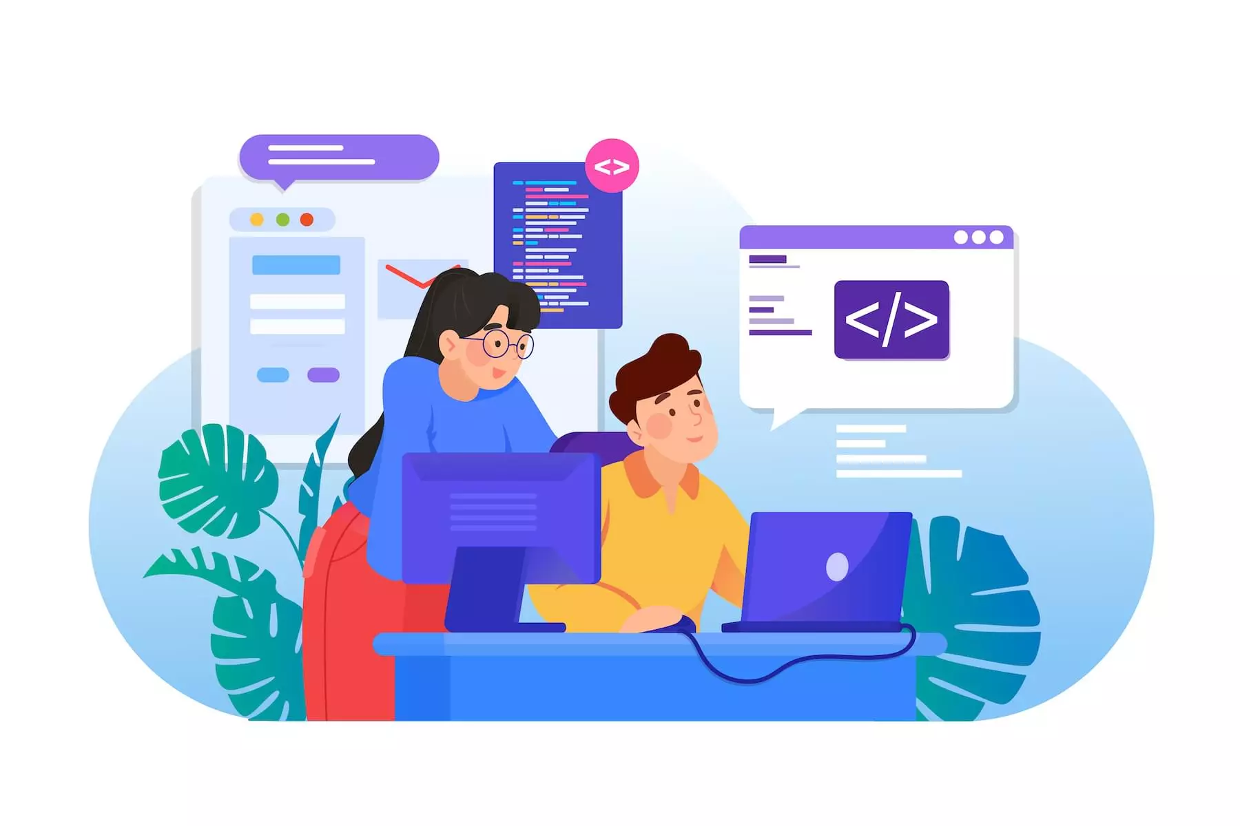
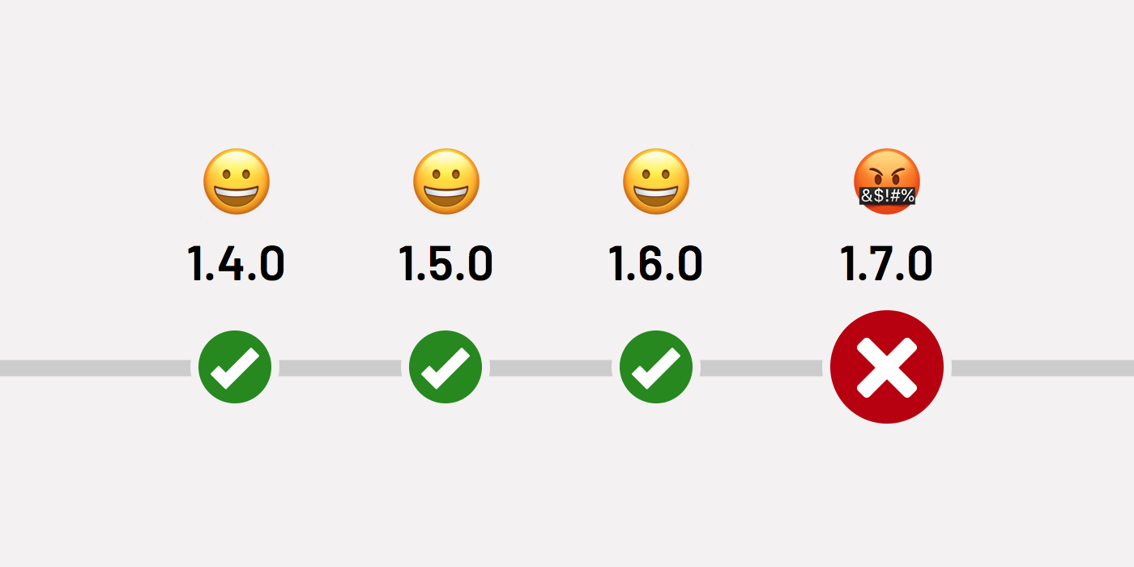
Why We Need Virtual Environment?
You might ask: shouldn’t I just install the latest Python version?
Sharing virtual environment to enable project collaboration
Isolate package versions to avoid breaking changes
Notes:
You have an application (developed by yourself or by someone else) that once worked beautifully. But now you’ve tried to run it, and it is not working. Perhaps one of the packages is no longer compatible with the other parts of your program (due to the so-called breaking changes).
You are collaborating with someone else, and you want to make sure that your application is working on your team member’s computer, and vice versa, so you can also set up an environment for your co-worker’s application(s).
You are delivering an application to your client, and again, you want to make sure that it is working smoothly on your client’s computer.

Slide 16
How To Create Virtual Environment?
Open Anaconda Prompt
Create new virtual environment with:
conda create --name bri_audit python=3.10
Check virtual environment
conda env list
Activate the new virtual environment:
conda activate bri_audit
Connection Not Yet
Established
Virtual Environment
Has Been Created

Slide 17
How To Make Virtual Environment Work?
Install required libraries:
pip install ipykernel
2. Create new kernel:
python -m ipykernel install --user --name=bri_audit

Slide 18
Thank You

Slide 19
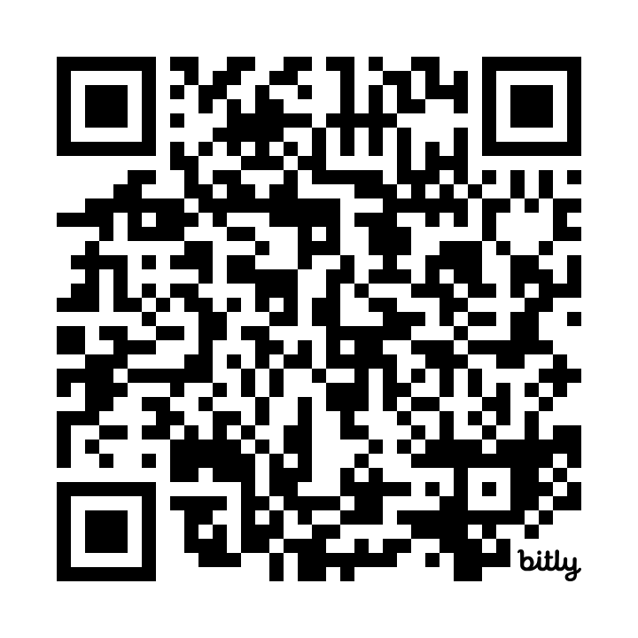
Feedback
https://bit.ly/feedback_briaudit_p4da

